Slide 1

IAG Take Home Exercise
Analytics Engineer
Carol Moynham
July 2025

Slide 2


Slide 3
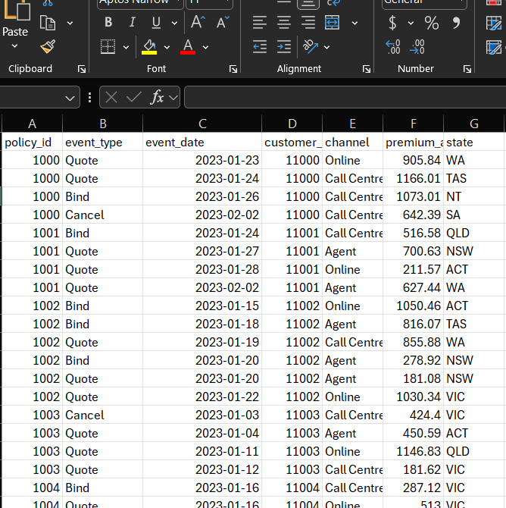

The ask: transform raw data into a clean, queryable, meaningful source for downstream users

Slide 4




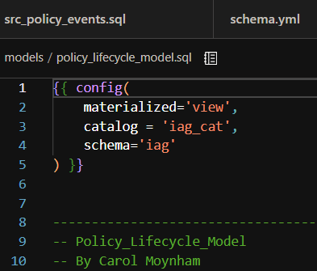
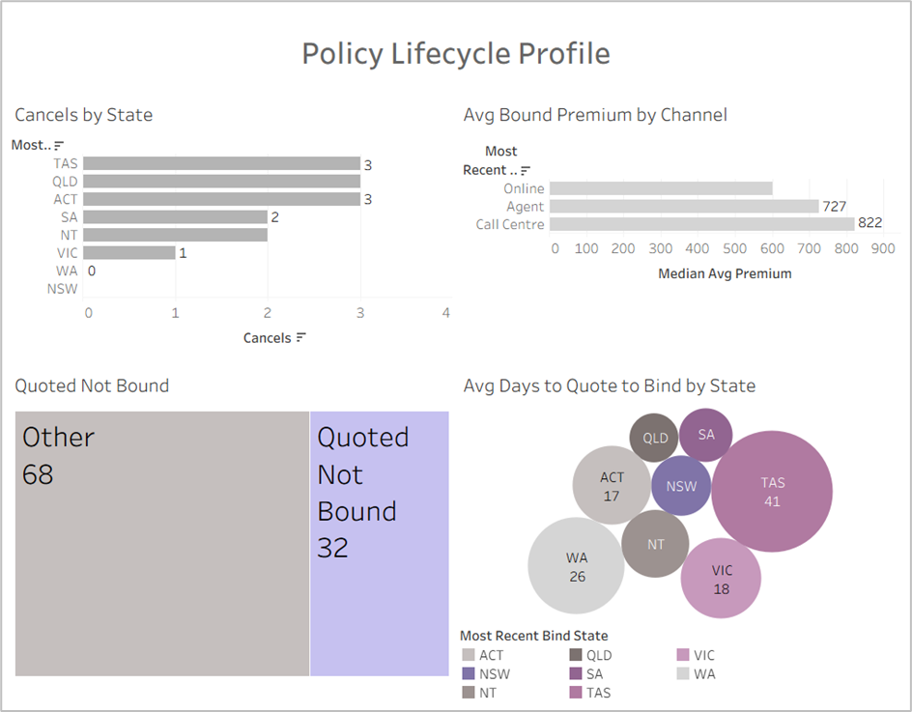
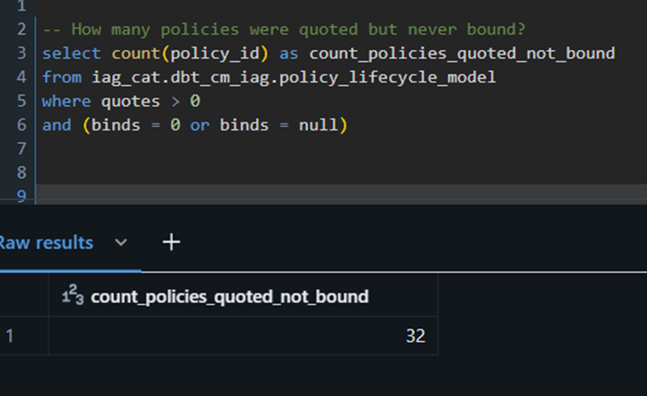

Four steps to transform raw data into a clean, queryable, meaningful source for downstream users
Set Up
Think
Model
Query and Share
Profile.yml
DB Token
Create accounts for DBT, DataBricks, GitHub
Create workspace and schema
Load Policy data into Databricks
Connect DBT, Data Bricks, GitHub
Re-read the exercise
Explore the data
Conceptualise model
Assumptions
Start by creating a source table with the raw data
Build the quote bind model to address need for specific journeys in this space
Summary
Queries in DataBricks
Self-serve dashboard
Document and Test across every stage

Slide 5

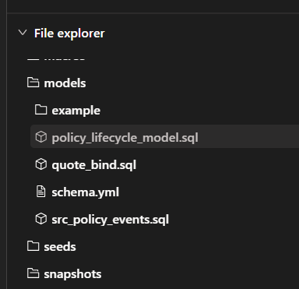
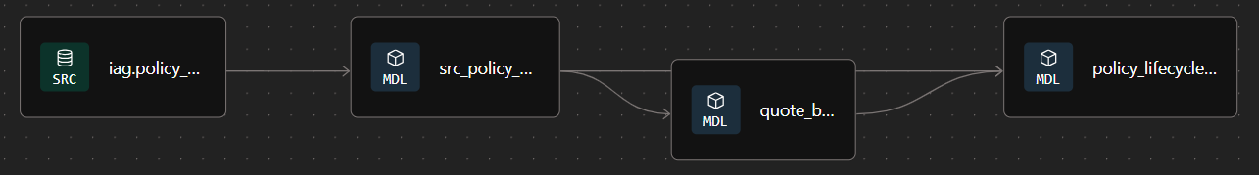
Three models built in DBT: src_policy_events, quote_bind and policy_lifecycle_model, documentation in schema.yml*
SRC_Policy_Events
Raw data
Could be cleaned or updated at this level if needed
Quote_Bind
To address the need for average time from quote to bind
Splits each quote-bind cycle into it’s own event, by policy
Policy_Lifecycle_Model
Summary combining data from source table and quote_bind
Single line per policy
Schema.yml
Documents metadata for models
Can also be used to document for seeds, sources and test
Option to automate .yml creation using AI tools like DBT Copilot (Cloud only)
* Models located here: https://github.com/C-Monsta/IAG-Take-Home-Test/tree/main/models

Slide 6
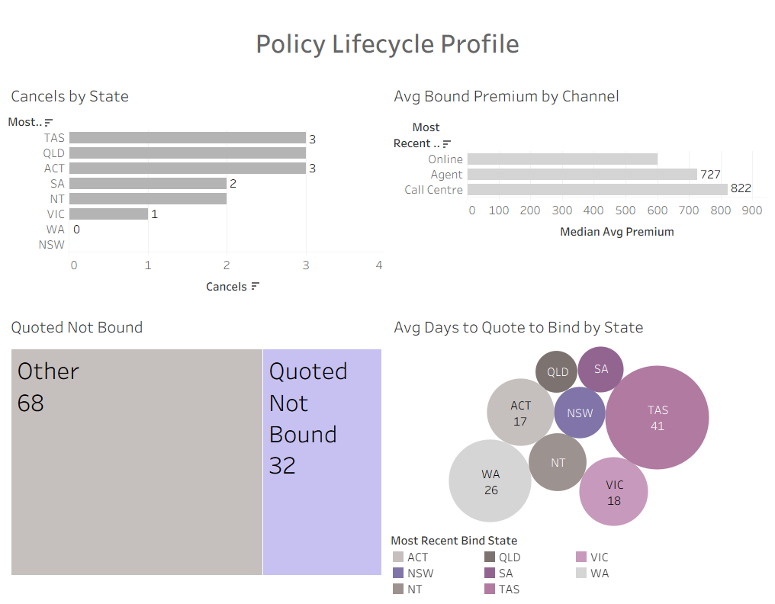
Exploring the data in Tableau
Visualisations can quickly explore and report on policy data

Slide 7
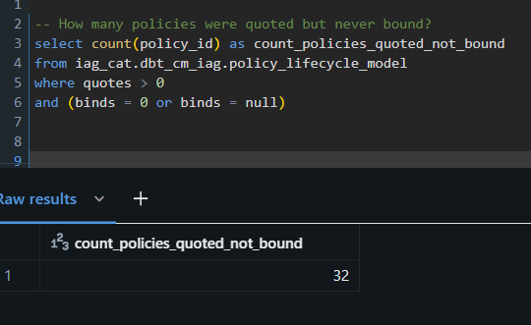
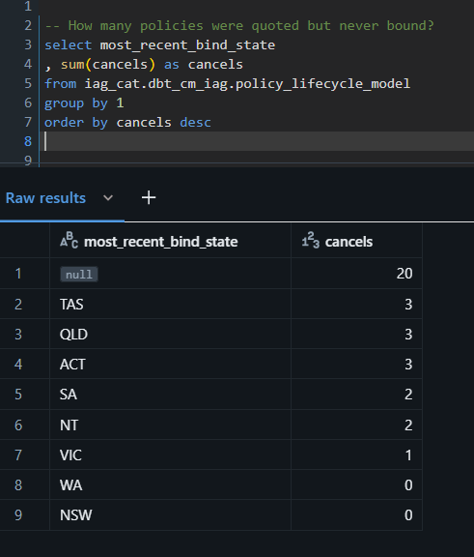
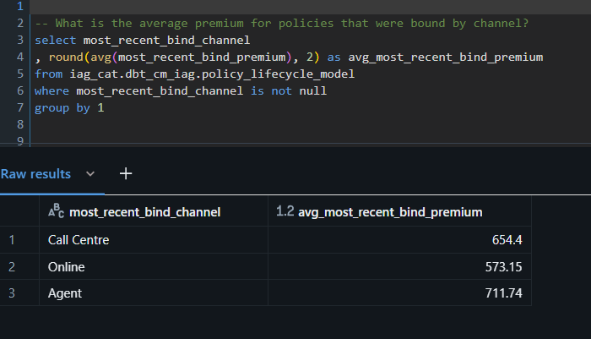
Exploring the data in SQL

Slide 8
Data Anomalies and Assumptions
Issue/ Anomaly | Action/ Assumptions
State of the sale can vary by quote and bind | For reporting use the most recent quote/ /bind. For historic performance, the larger src table can be used
Some bind premiums values will be null as not all policies were bound. Should these be reformatted to 0 | Leaving as null so it’s clear the policy wasn’t bound, as opposed to having 0 premium. Can be defaulted to 0 during calculated fields as needed
How to manage multiple quotes on the same day | Currently the field is date only. DateTime would show different quotes on the same day. Alternately a unique quote ID may work
Updating the models | These are currently set to create a materialized view. These could be set to refresh incrementally. Would need to explore how often policy details change historically to determine kind of incremental method to use
Policy Lifecycle is one line per policy. Some of the more granular detail will be lost | For more detailed querying the deeper models can be used

Slide 9

Thank you!

Slide 10
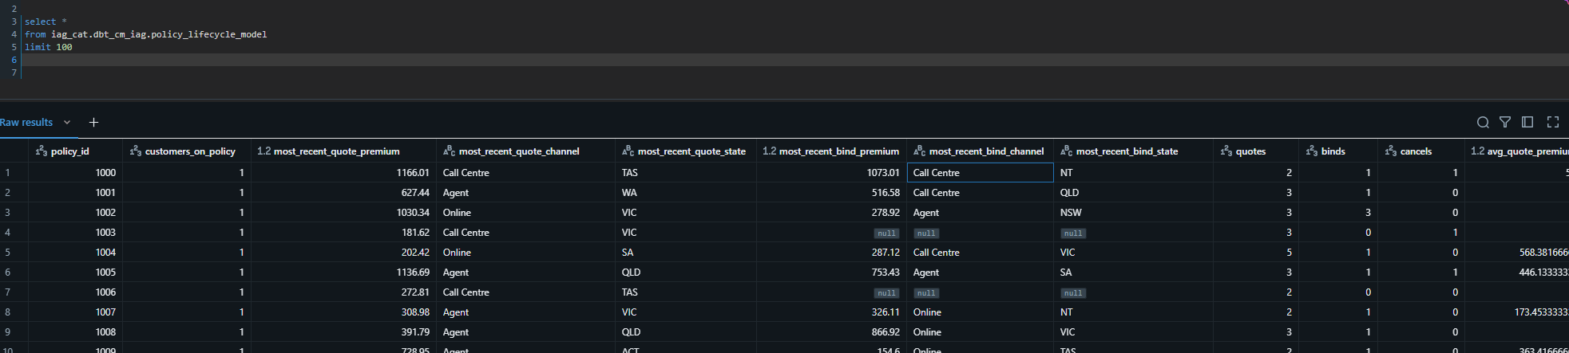
Appendix 1: Policy Lifecycle Model
* Models located here: https://github.com/C-Monsta/IAG-Take-Home-Test/tree/main/models

Slide 11
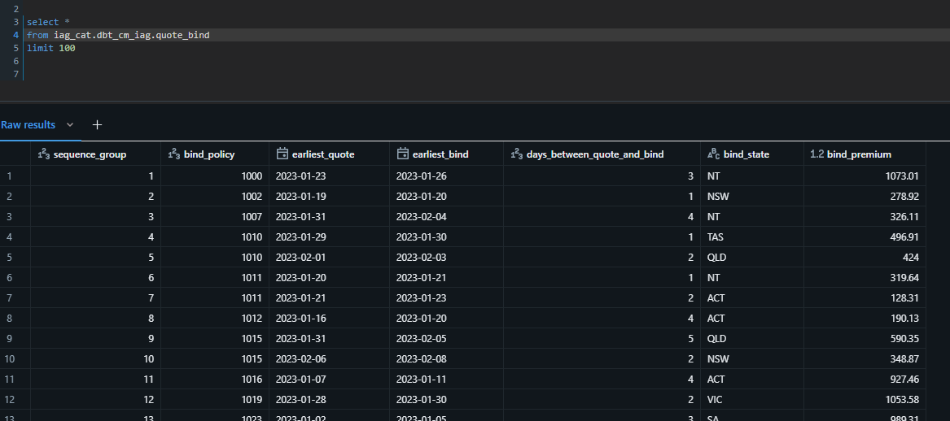
Appendix 2: Quote Bind Model
* Models located here: https://github.com/C-Monsta/IAG-Take-Home-Test/tree/main/models

